Slide 1

LoRaWAN implementation for acoustic localization of coyotes
Team Coyote1
2022 KSW Fall Program - Final Presentation

Slide 2

01. Introduction
02. Implementation
CONTENTS
03. Experiment
04. Future works
2022 KSW Fall Program - Final Presentation

Slide 3







Team members
Hyemin Lim
Chung-Ang University
Computer Science and Engineering
Hyeongjun Kim
Daegu Catholic University
Computer Engineering
Jaehui Boo
Dankook University
Computer Engineering
Nayoun Kim
Woosong University
Information Technology Convergence
Justin Anderson
Purdue University
Network Engineering Technology
Wei-Chieh Chin(Victor)
Purdue University
Computer & Information Technology

Slide 4
Introduction
01
Introduction

Slide 5
1.1 What has changed since the Midterm
The Things Stack
Throughput
Acoustic
Sensor
NodeMCU
LoRaWAN
Acoustic
Sensor
Raspberrypi
LTE/Wifi
Application
Server
Gateway
MQTT
NodeMCU
Machine Learning /
Deep Learning
Visualize
Acoustic
Sensor
NodeMCU

Slide 6
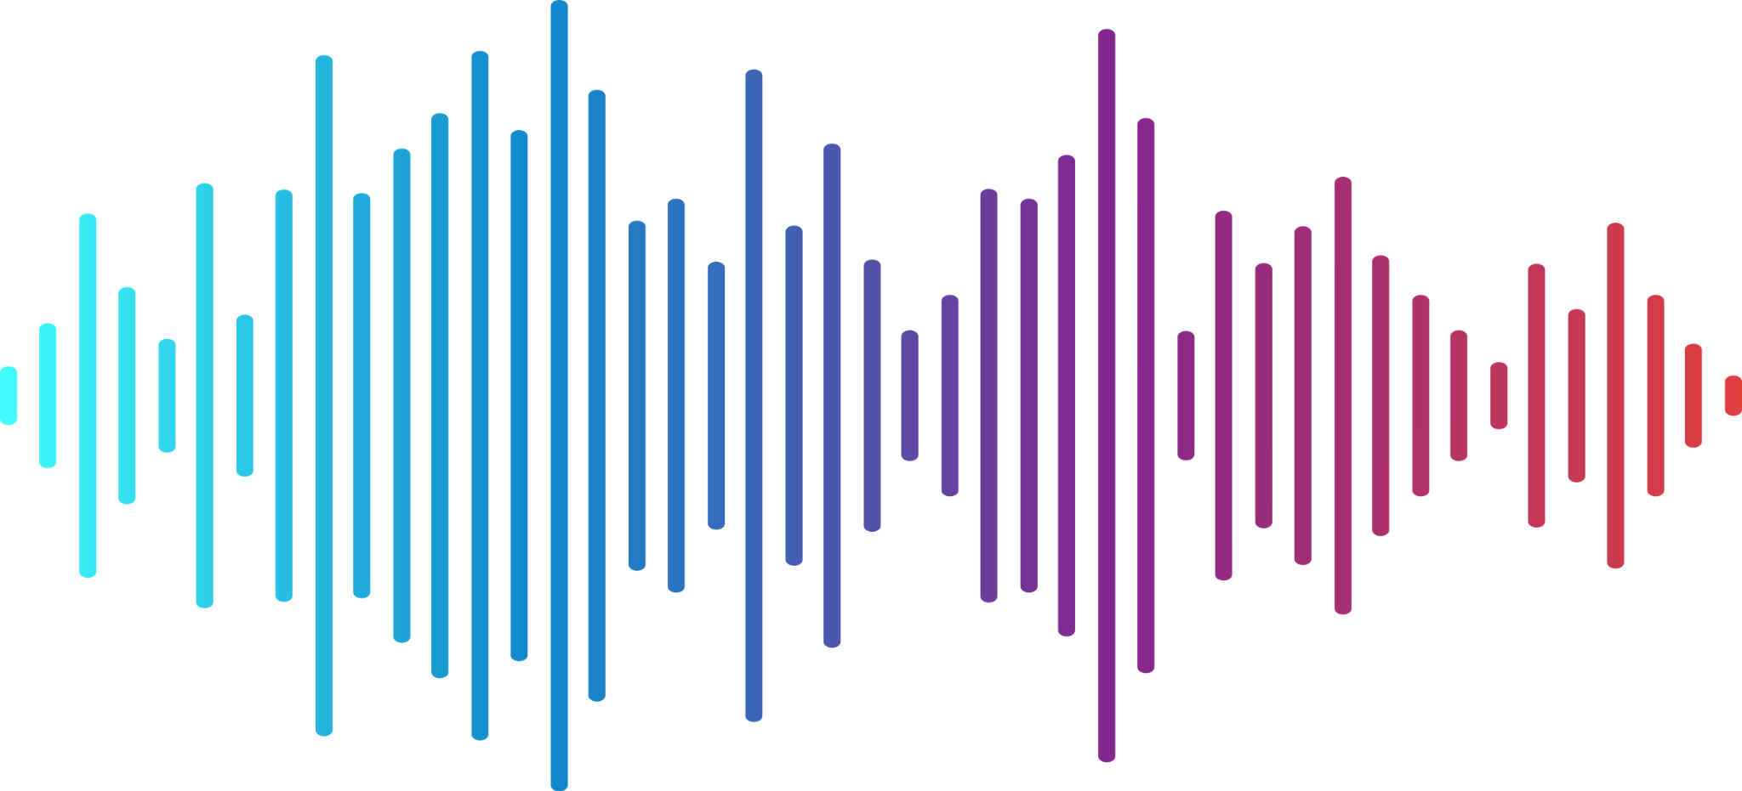
1.1 What has been changed since the Midterm
LoRaWAN Frame
243
Frame Payload
Sig
…121…
Sig
3 seconds of Audio * 16000 sampling rate
= 48000 audio signals
48000 / 121 = 400

Slide 7
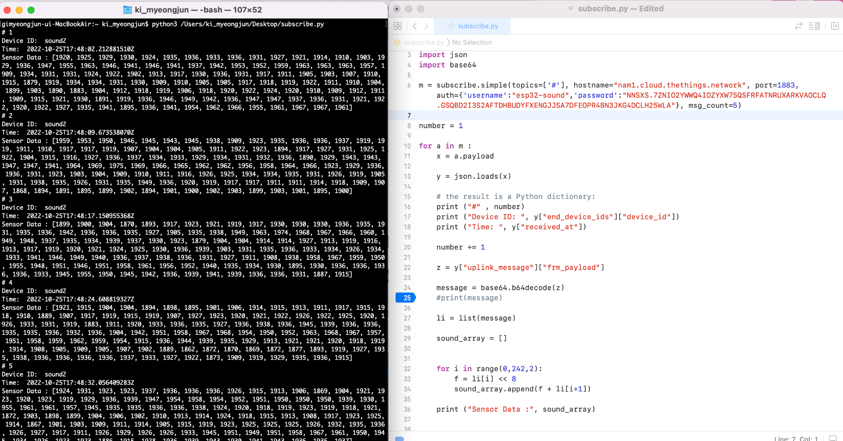
1.1 What has been changed since the Midterm
2600bps
Transmission starts:
17:48:02
Transmission ends:
18:36:02
=48min

Slide 8
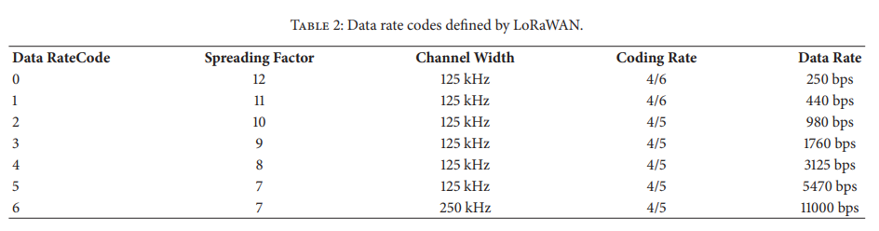
1.1 What has been changed since the Midterm
[1] Hindawi., "Performance Evaluation of LoRaWAN Communication Scalaility in Large-Scale Wireless Sensor Networks”, in WCMC, vol. 2018, June. 2018, Art no. 6730719
7
125kHz
4/5

Slide 9
1.1 What has been changed since the Midterm
Acoustic
Sensor
LoRaWAN
MQTT
NodeMCU
Gateway
Machine Learning
Raspberrypi
serial connection
LoRaWAN
NodeMCU
Gateway
Acoustic
sensor
Machine Learning

Slide 10
1.2 New Project Architecture
The Things Stack
Raspberrypi
Acoustic
sensor
Machine Learning
LoRaWAN
(ESP32)
Raspberrypi
MQTT
Localization
websocket
Node.js
(Server)
Gateway
Acoustic
sensor
Machine Learning
Raspberrypi
Acoustic
sensor
Machine Learning
Unity
(Visualization)

Slide 11
Implementation
01
02
Implementation
End node connection
Localization
Visualization

Slide 12
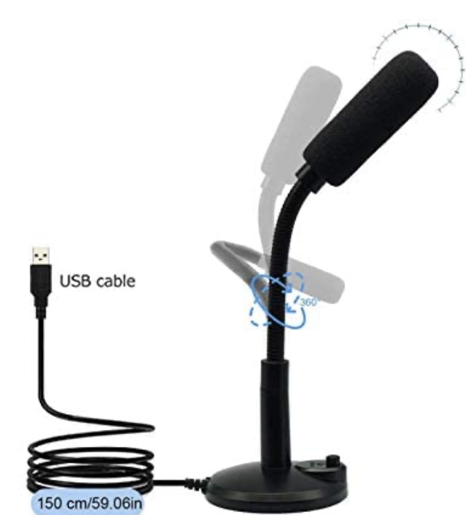
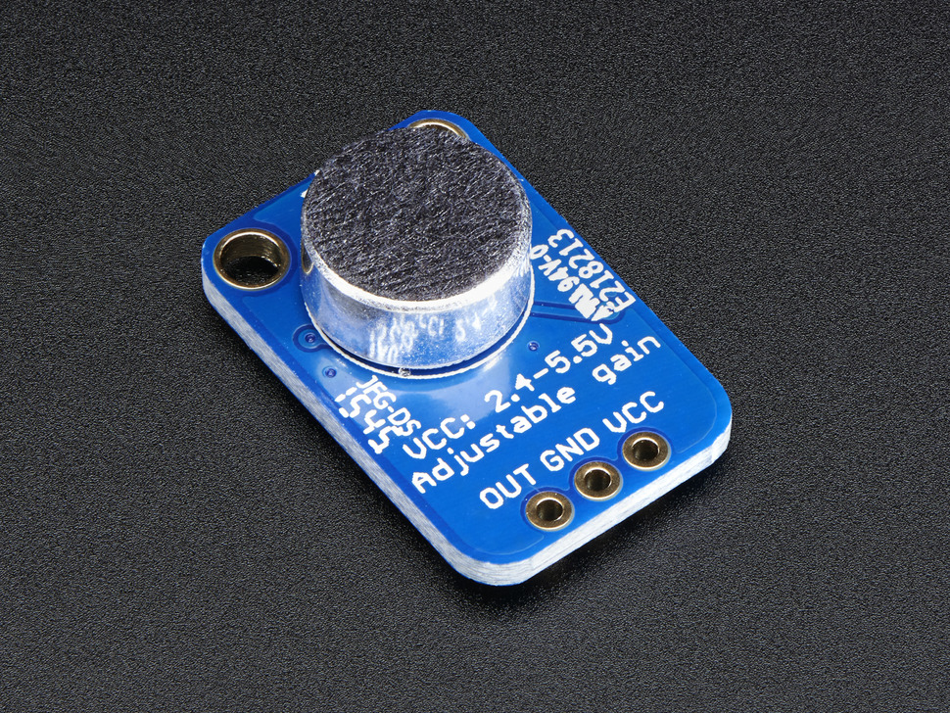


2.1 End node connection
MAX4466
AK5371

Slide 13
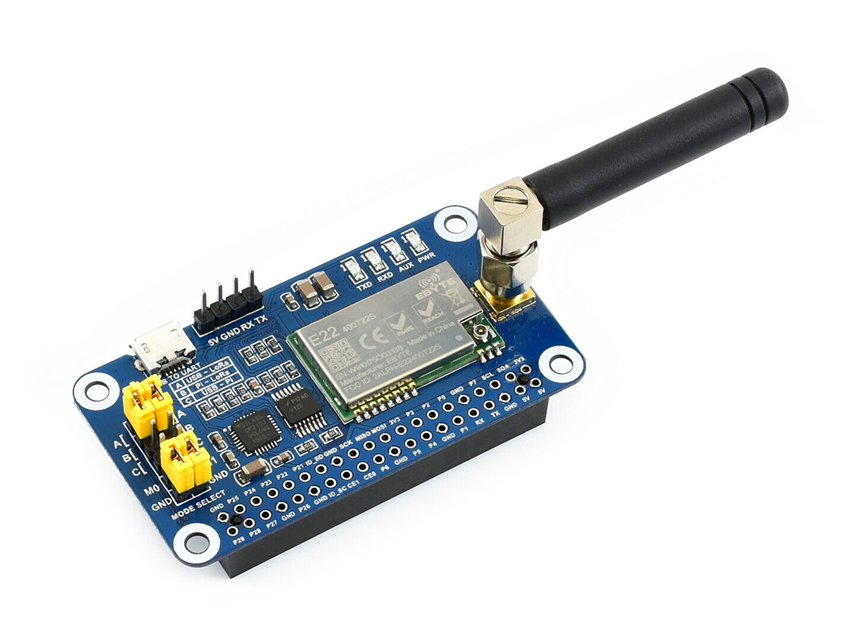


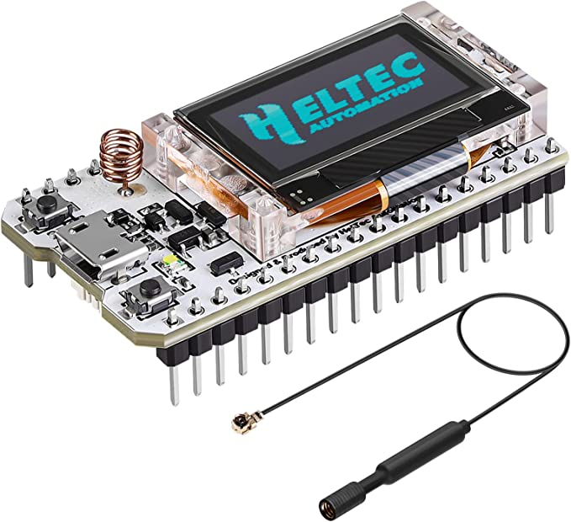
2.1 End node connection
USB
Stable result
easy to use
(thanks to pyserial)

Slide 14
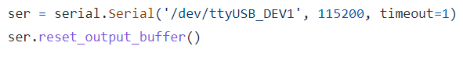
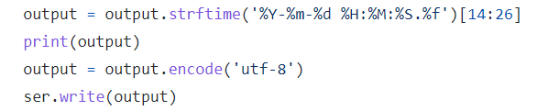

2.1 End node connection
Raspberry Pi
Timestamp
Payload(Timestamp)
ESP 32

Slide 15

2.2 Raw frame data processing
LoRaWAN Frame
base64
Frame Payload
Localization
ascii
time value
calculation
datetime
time difference value

Slide 16
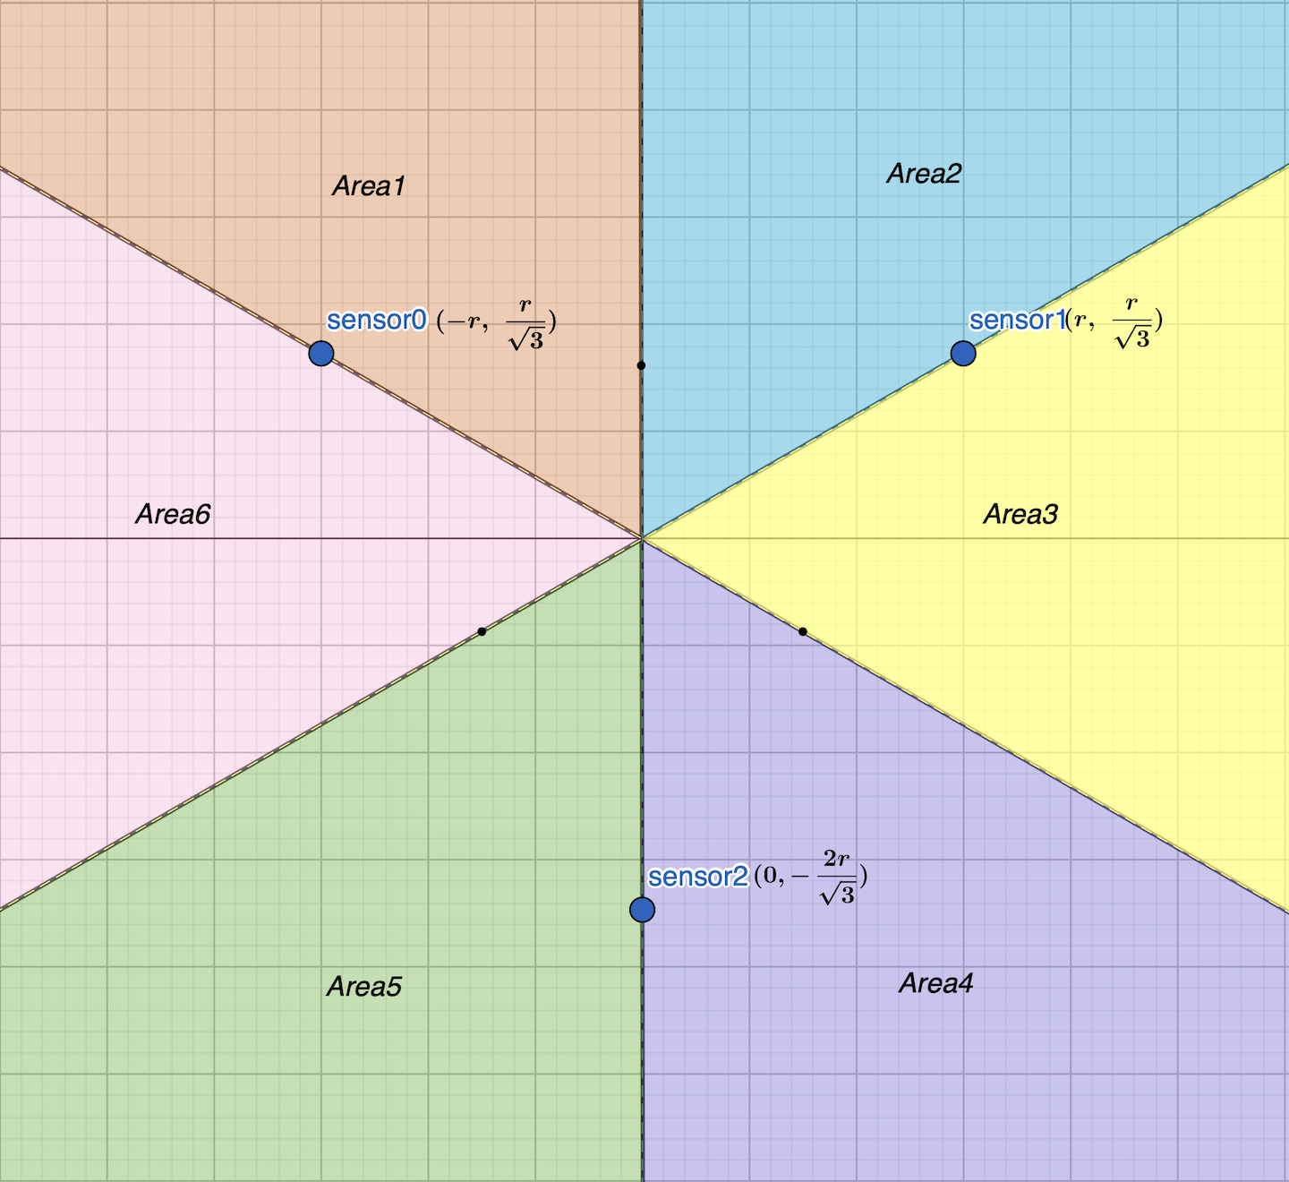
2.2 Localization
Unit: cm, ms
2r
time0_obj
time1_obj
td0
td1
td2
v
Area
time2_obj

Slide 17
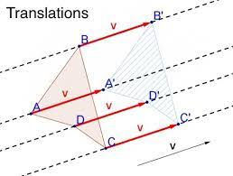
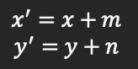
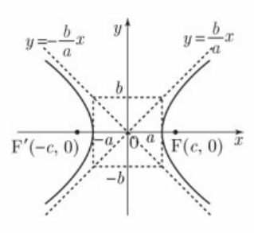
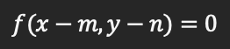
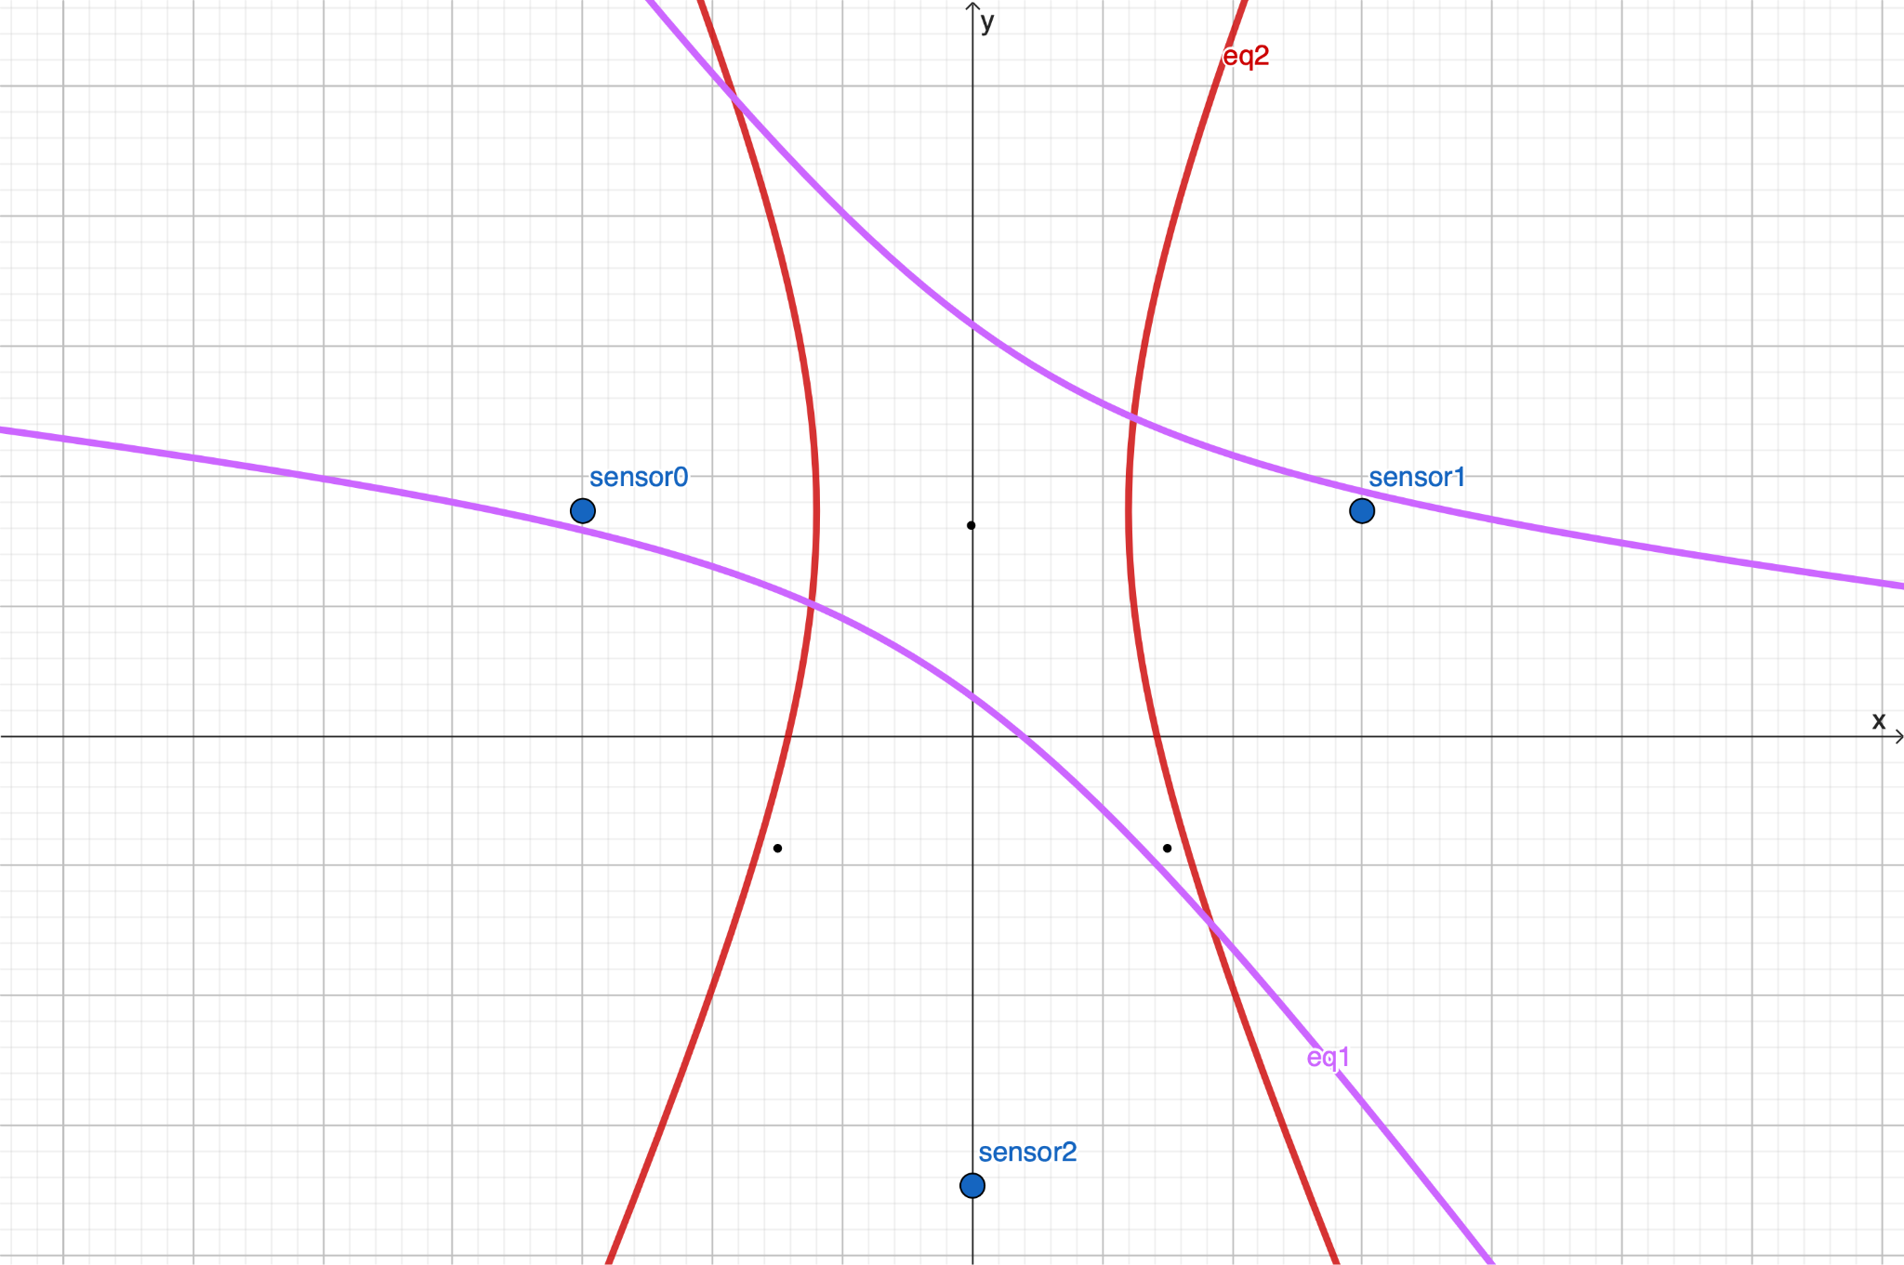
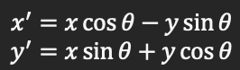
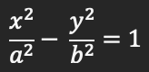
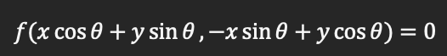
2.2 Localization
Hyperbolic function
Parallel Translation
Rotation Transformation

Slide 18
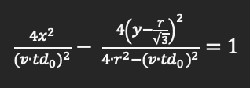
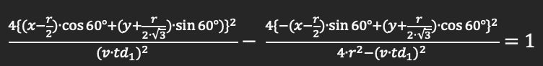
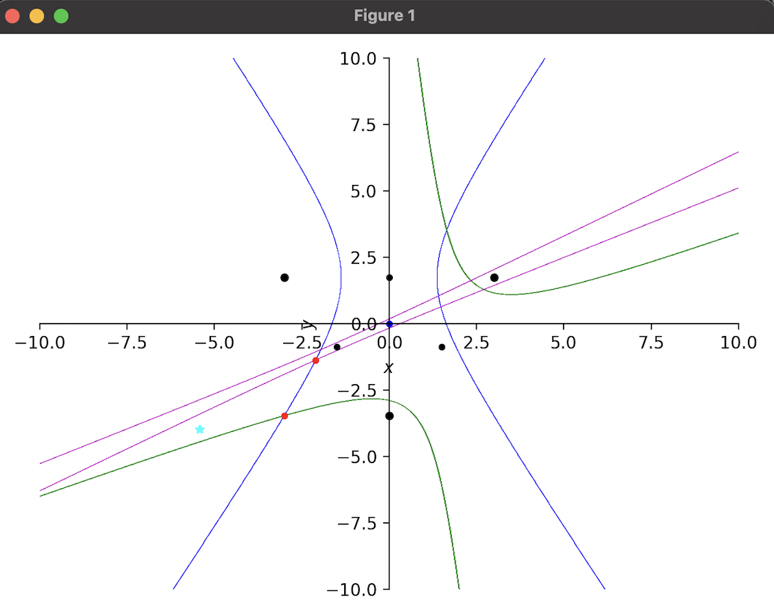
2.2 Localization

Slide 19
2.2 Localization
2
3
1

Slide 20
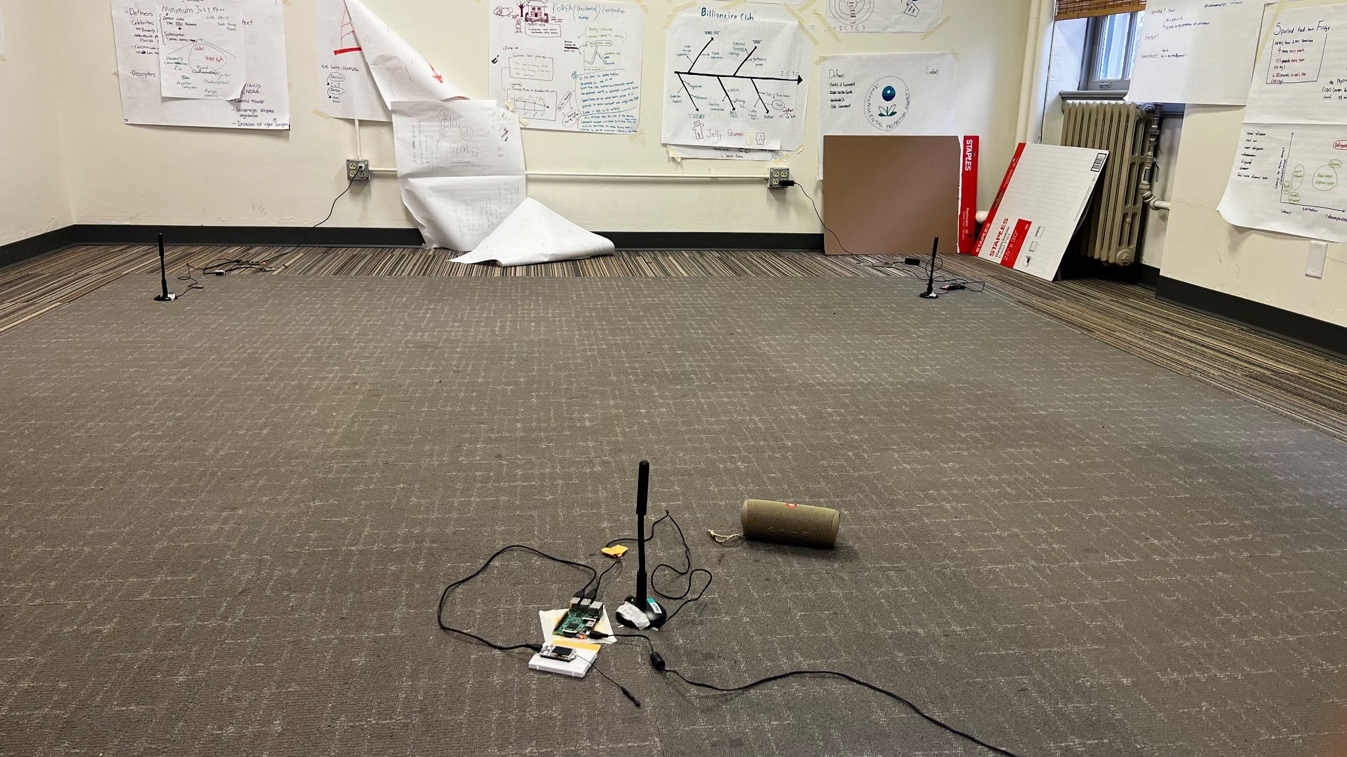
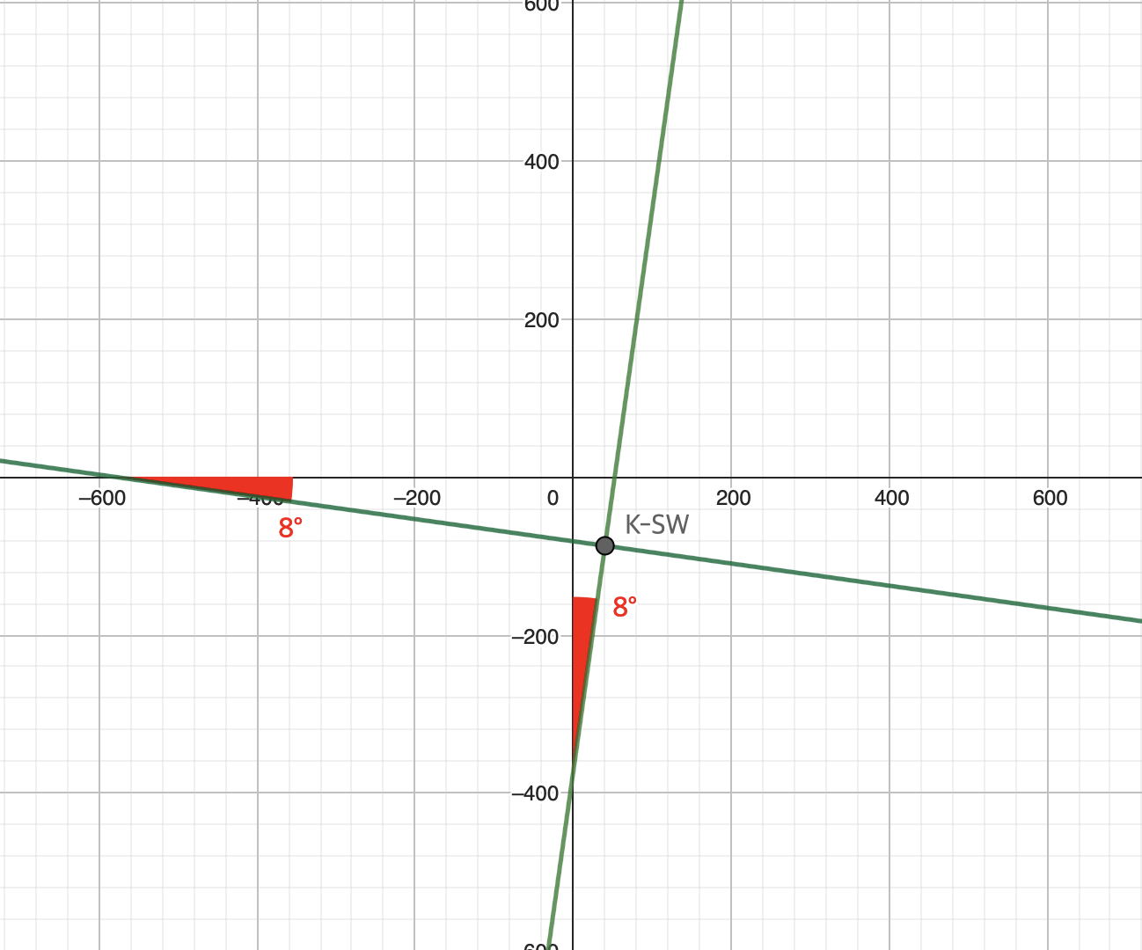
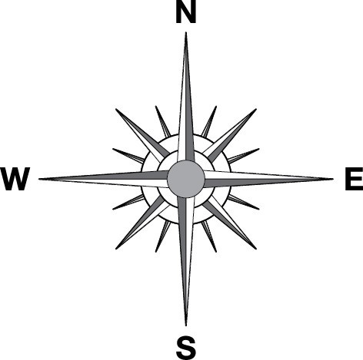
2.2 Localization
(m, n)
(40.426…, -86.909…)
(unit: cm)
(unit: °)

Slide 21
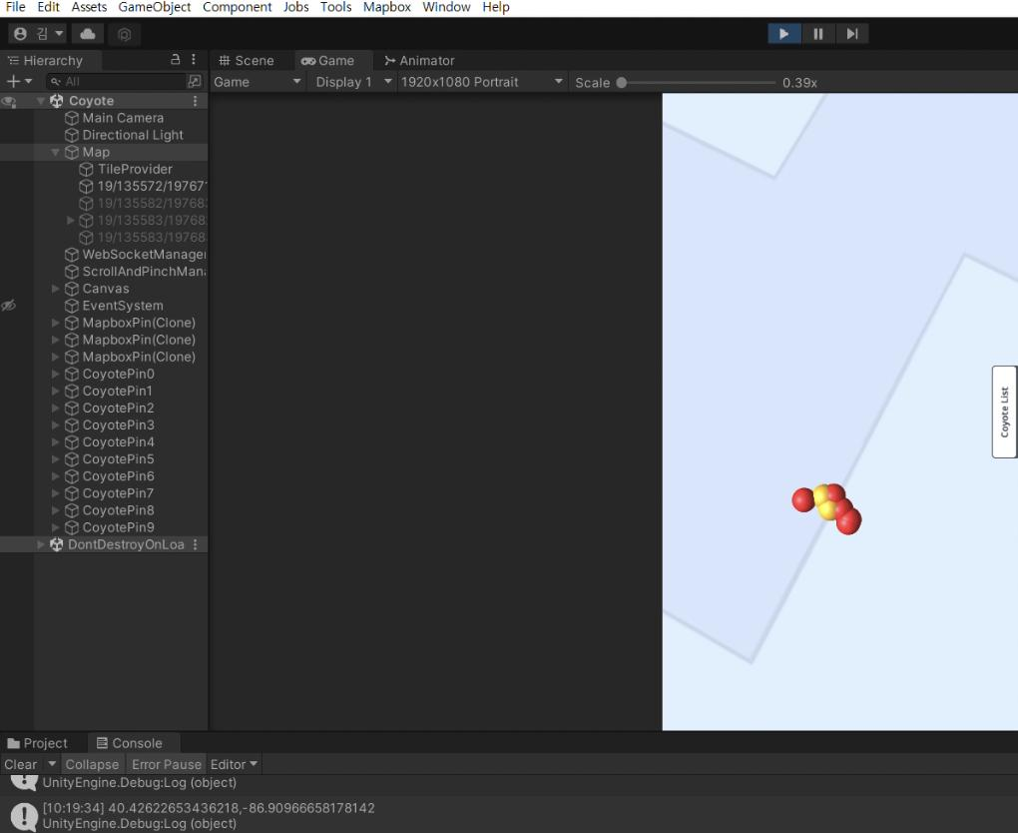
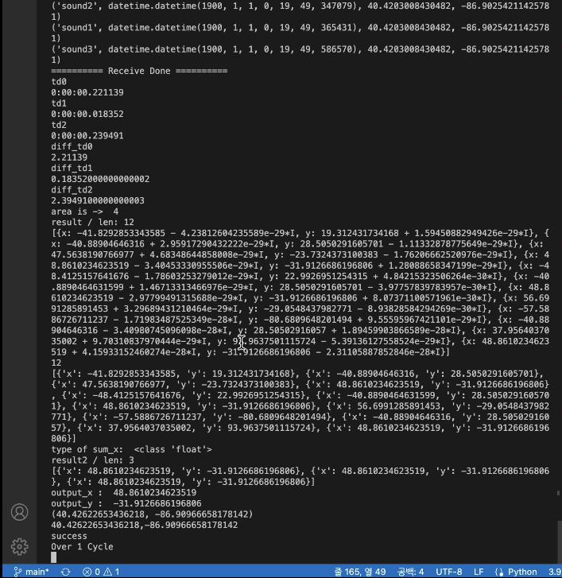



2.3 Visualization
coyote detection history (recent 5)
sensor coordinates
Localization
coordinates
http
websocket
real-time detection
websocket
Mapbox SDK
collections
sensors
coyotes

Slide 22
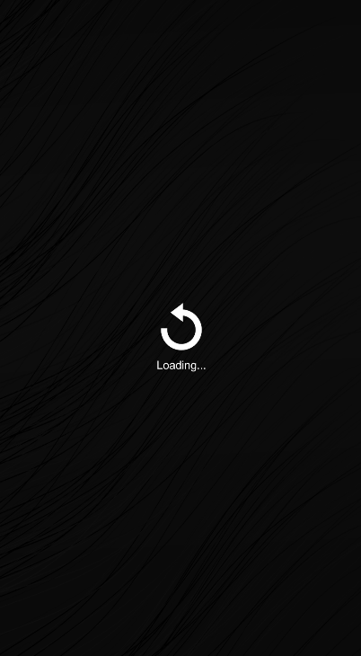
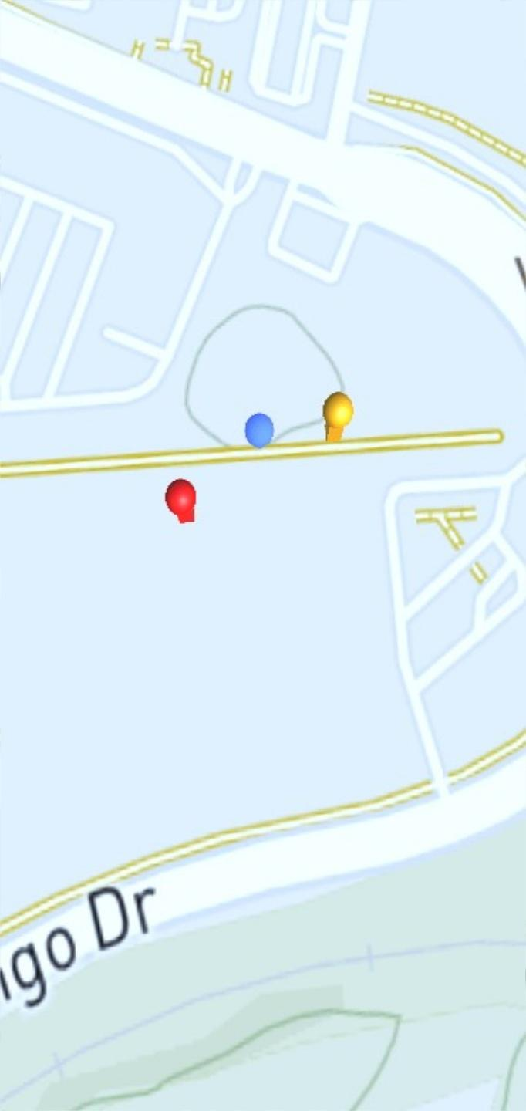
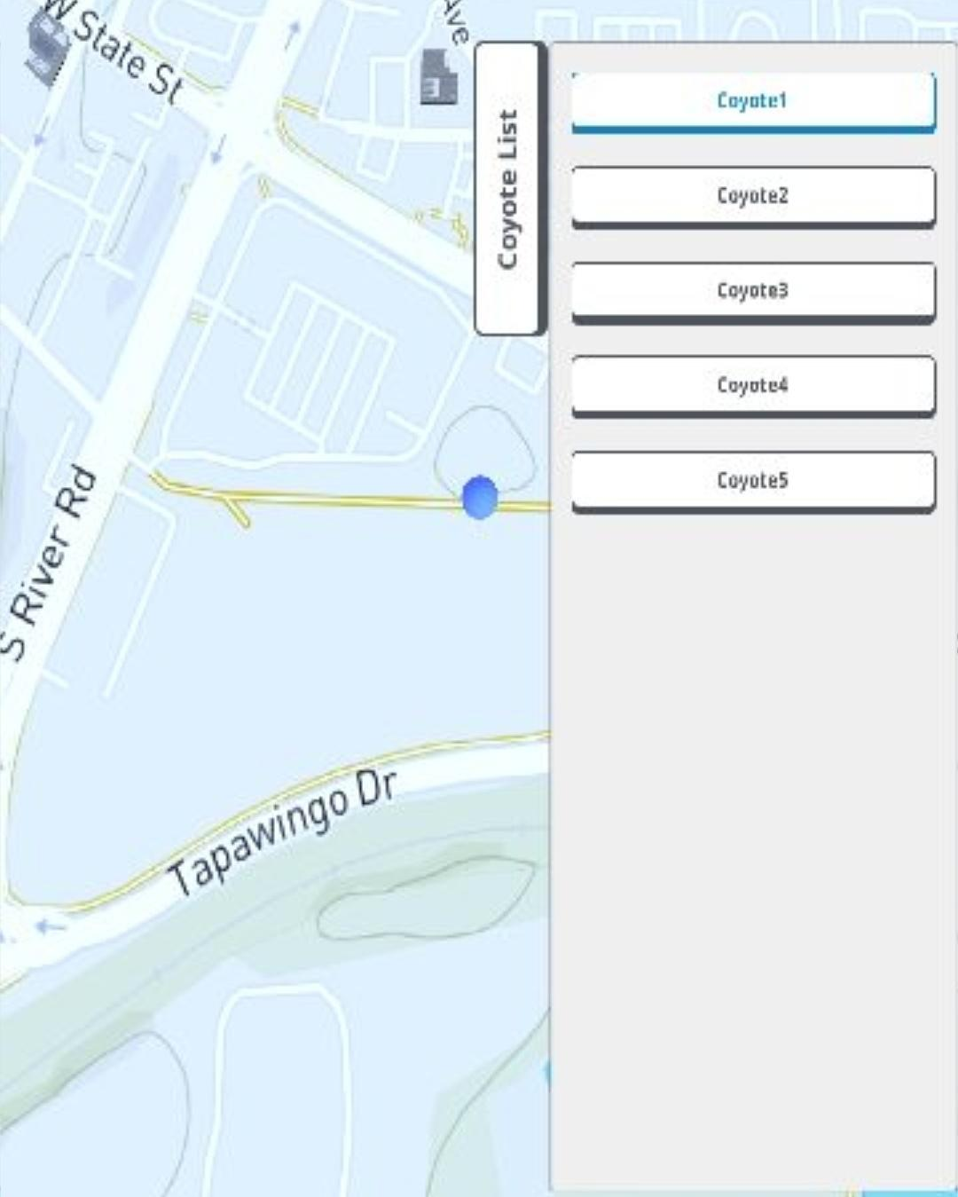
2.3 Visualization

Slide 23
Experiment
03
Experiment

Slide 24
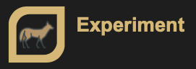
3. Experiment
Sound Detect
Packet
ESP32
Gateway
Sensors
(Each sensors distance is same)
Localization

Slide 25
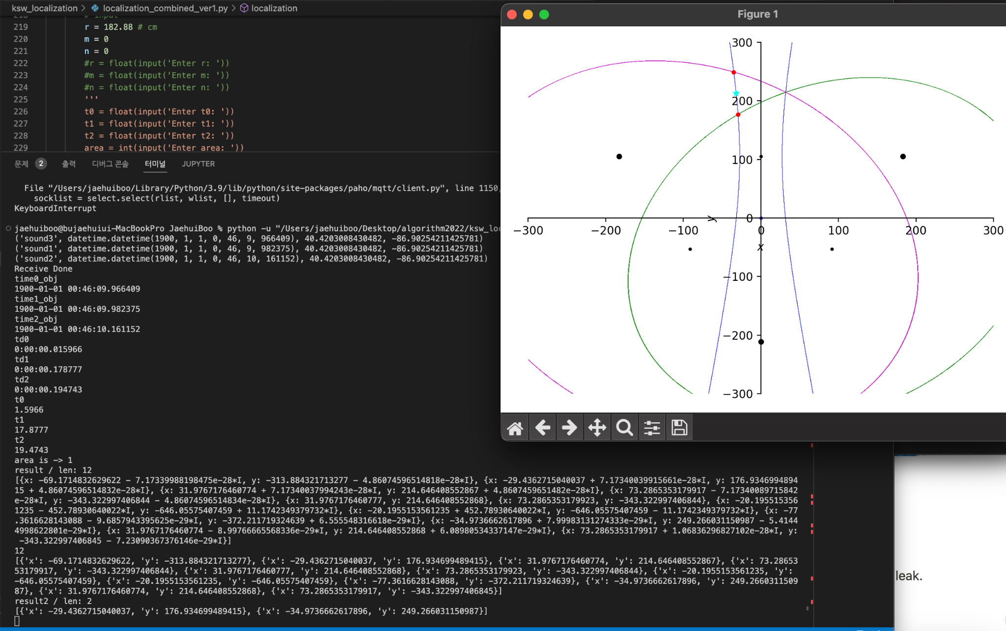
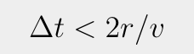
3. Experiment
Wrong Result

Slide 26
3. Experiment
Sensor Distance: 60ft
Sensor Distance: 144ft

Slide 27
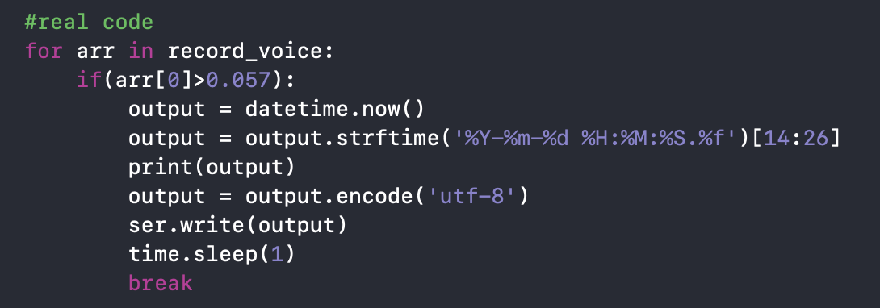
3. Experiment

Slide 28
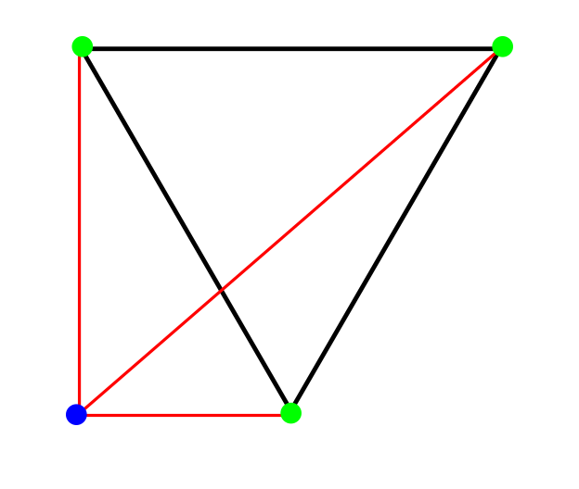
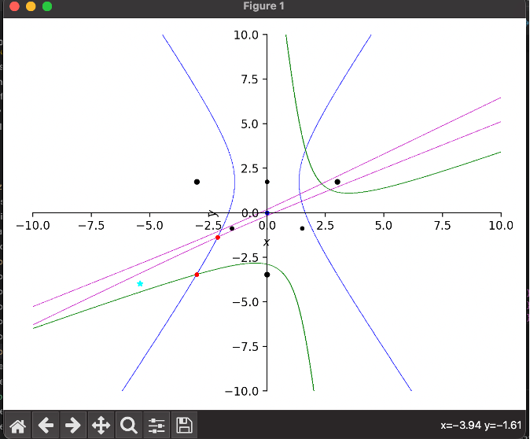
3. Experiment
Sensor0
Sensor1
Sensor2

Slide 29
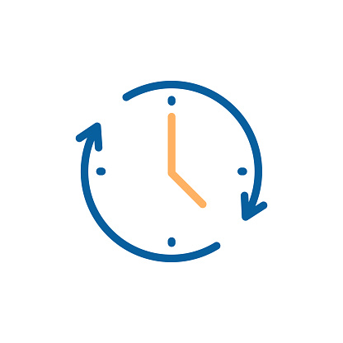
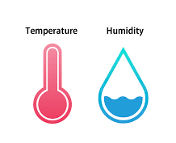
3. Experiment
Time Delay?

Slide 30
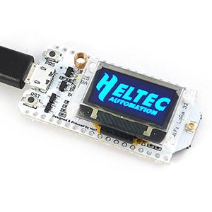
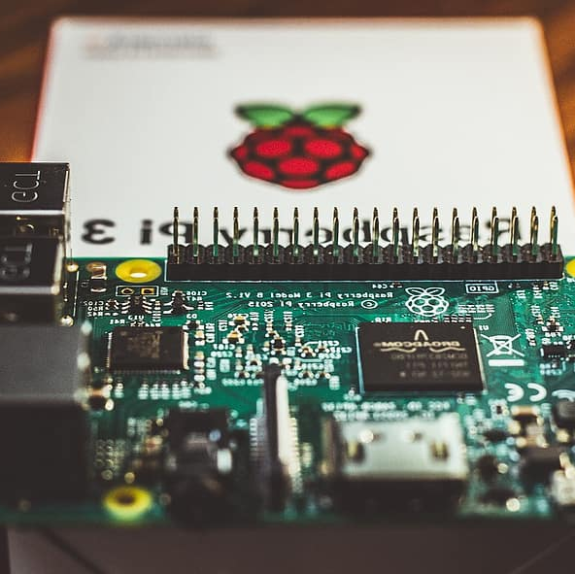
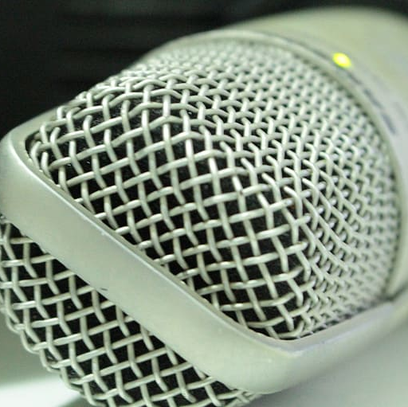
3. Experiment
Time Delay?
1m Length usb cable took 10ns to communicate

Slide 31
3. Experiment
Sound1
Sound2
Sound3
AVG : 31.096ms
AVG : 33.565ms
AVG : 37.038ms
Biggest problem is
recognition accuracy

Slide 32
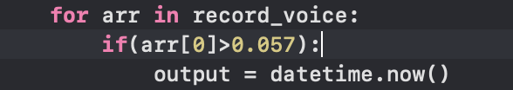
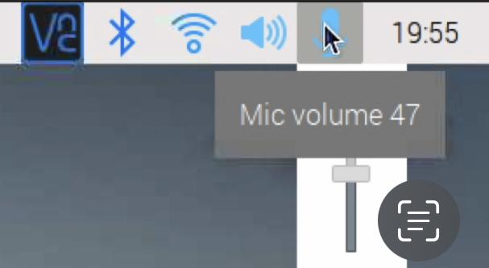
3. Experiment

Slide 33
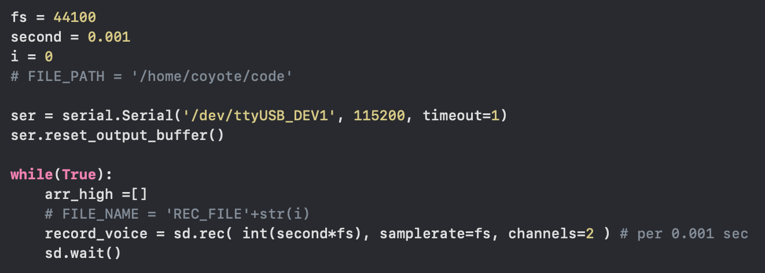
3. Experiment
Frame Value
📌
10ms
1ms
0.1ms

Slide 34
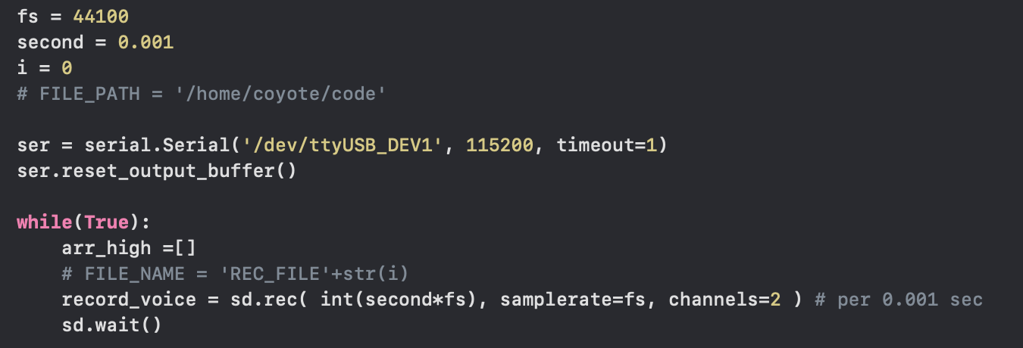
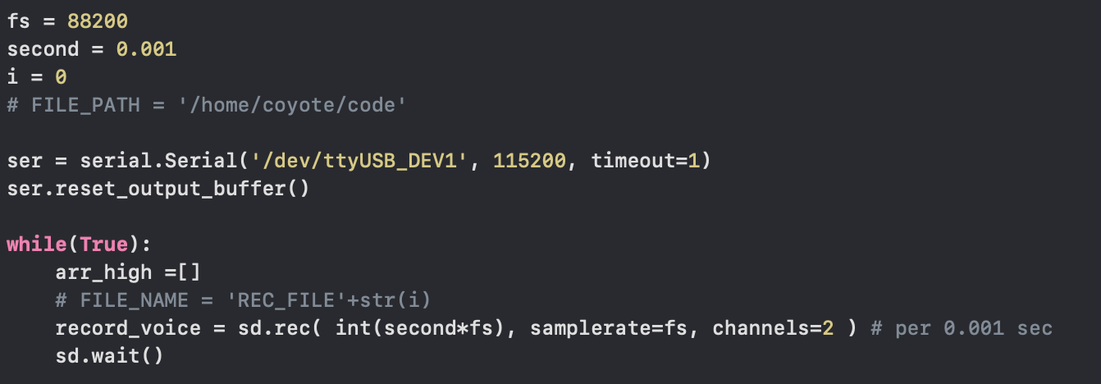
3. Experiment
Sampling Rate x 2

Slide 35
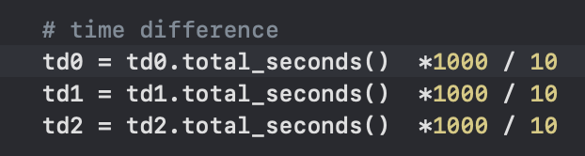
3. Experiment
Calibration Value

Slide 36
3. Experiment
acoustic sensor
Sound Source

Slide 37
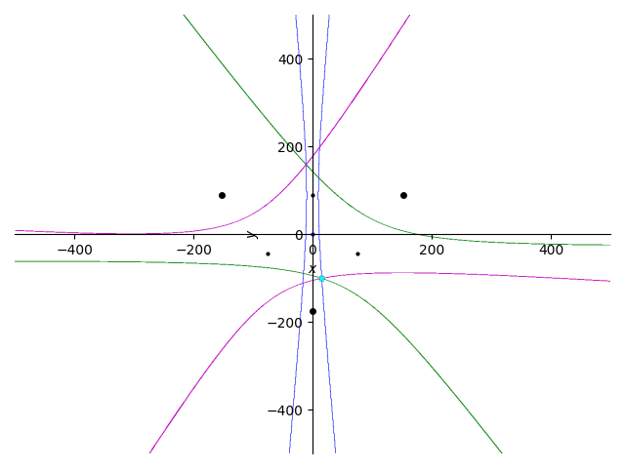
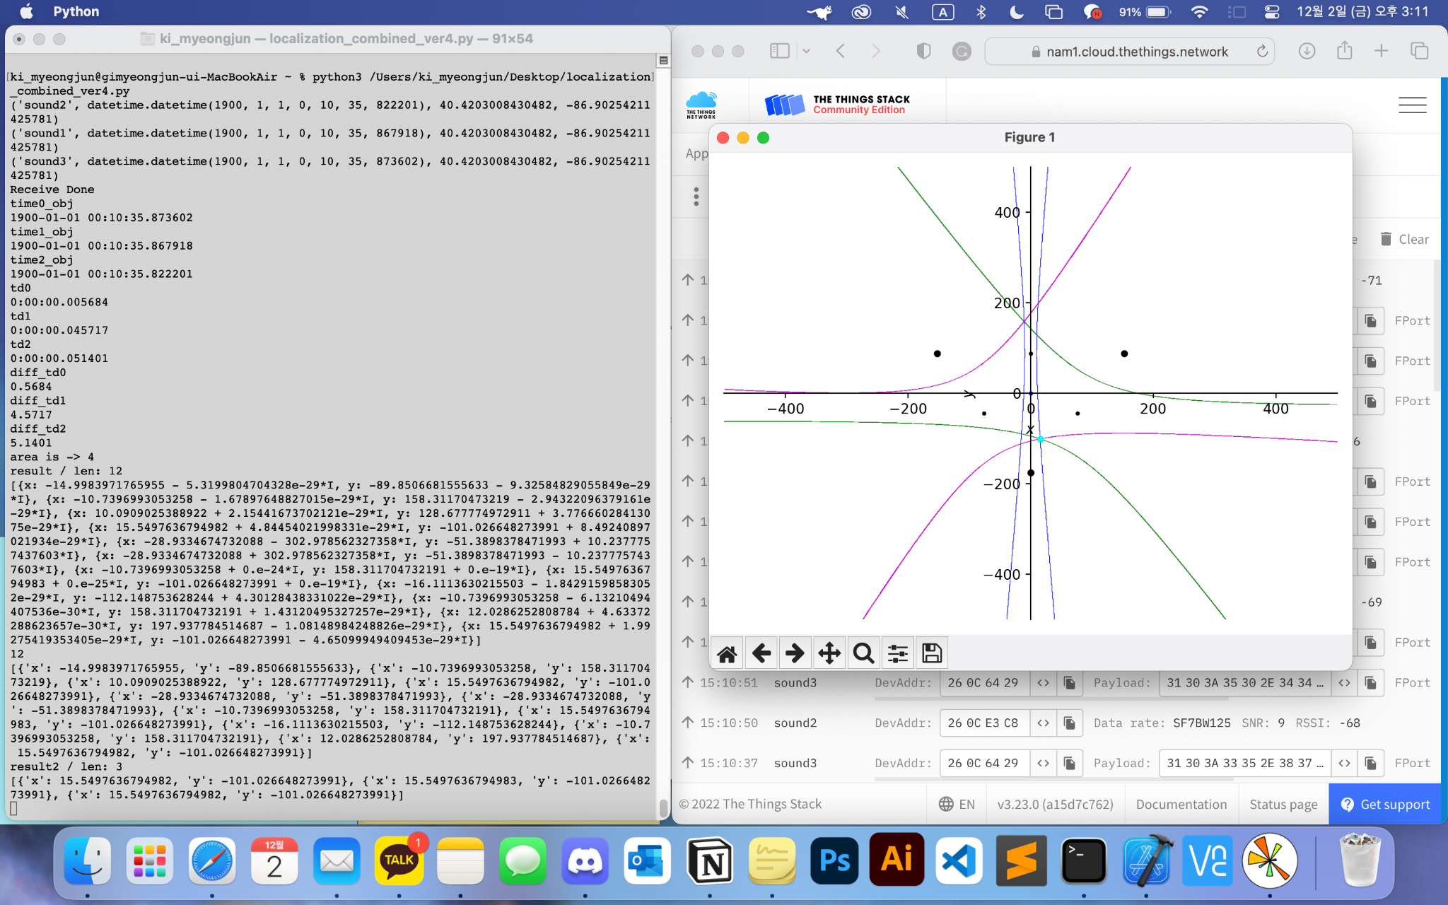
3. Experiment
Correct Location!

Slide 38
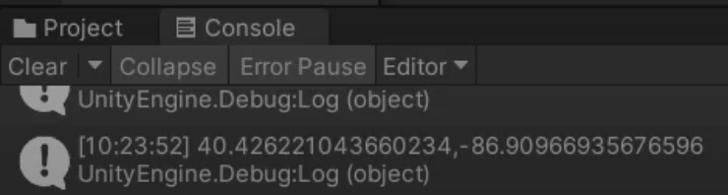
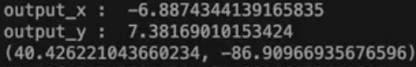


3. Experiment

Slide 39

3. Experiment

Slide 40




3. Experiment

Slide 41
Future Works
04
Future works

Slide 42

4. Future Works
Machine Learning Model Detection
=> ‘Decibel’ (as substitute)
Sensor Sensitivity
Many other sounds !
Future Works

Slide 43
[References]
[1] Wave Share. “SX1262 868M LoRa HAT” Wave Share. Accessed: Nov, 2, 2022. [Online]. Available: https://www.waveshare.com/wiki/SX1262_868M_LoRa_HAT
[2] Spotpear. “Raspberry Pi SX1262 868M LoRa HAT User Guide” Spotpear. Accessed: Nov, 2, 2022. [Online]. Available: https://www.spotpear.com/index/study/detail/id/244.html
[3] sb Components. “Getting started with LoRa™ Hat for raspberry pi” sb Components. Dec, 10, 2021. [Online]. Available: https://shop.sb-components.co.uk/blogs/posts/getting-started-with-lora-hat-for-raspberry-pi
[4] Jac. K. “Gateway SX 1262” The Things Network Forum. Jun 13, 2021. [Online]. Available: https://www.thethingsnetwork.org/forum/t/gateway-sx-1262/48750
[5] viveknayyar007 “How To Change Default Internet Connection Sharing IP Address Range” Tom's Hardware Forum. Dec, 12, 2013. [Online]. Available: https://forums.tomshardware.com/faq/how-to-change-default-internet-connection-sharing-ip-address-range.1606758/
[6] Lydia. C. “Connecting a Raspberry Pi to a Laptop Display” Atomic Object. Jun, 9, 2019. [Online]. Available: https://spin.atomicobject.com/2019/06/09/raspberry-pi-laptop-display/
[7] Dexter Industries “Connecting to Raspberry Pi without a monitor for Beginners” Dexter Industries. Accessed: Nov, 2, 2022. [Online]. Available: https://www.dexterindustries.com/howto/connecting-raspberry-pi-without-monitor-beginners/
[8] jurosofish, “multilateration” Github.com, Nov, 4, 2022. [Online]. Available: https://github.com/jurasofish/multilateration/pulse
[9] automaticaddison. “Two Way Communication Between Raspberry Pi and Arduino” Automatic Addison. Jul, 6, 2020. [Online]. Available: https://automaticaddison.com/2-way-communication-between-raspberry-pi-and-arduino/

Slide 44
[References]
[10] Hopkins. J. “Understanding the difference between UART and USB” Totalphase. Accessed: Nov, 11, 2022. [Online]. Available: https://www.totalphase.com/blog/2022/01/understanding-differences-between-uart-and-usb/
[11] Press Start. “Unity - Mobile Panning with a Perspective Camera” Youtube. Nov, 9, 2018. [Online]. Available: https://www.youtube.com/watch?v=4_HUlAFlxwU
[12] Google. “Maps SDK for Unity Key Concepts” Googles map platform. Accessed: Nov, 9, 2022. [Online]. Available: https://developers.google.com/maps/documentation/gaming/concepts_musk
[13] Kristopher C. “A Guide to Using Google’s Maps SDK for Unity 3D - Part 1” Medium. Apr, 19, 2021. [Online]. Available: https://medium.com/everdevs-community/a-guide-to-using-googles-new-maps-sdk-for-unity-3d-ed1d68b2305e
[14] Ahmed. S. “WebSocket Client & Server (Unity & NodeJS)” Medium. Dec 6, 2020. [Online]. Available: https://medium.com/unity-nodejs/websocket-client-server-unity-nodejs-e33604c6a006
[15] SymPy Development Team. (2022). Accessed: Aug. 22, 2022. [Online]. Available: https://docs.sympy.org/latest/tutorials/intro-tutorial/index.html
[16] Python. “datetime” python software foundation. Accessed: Nov, 16, 2022 [online]. Available: https://docs.python.org/3/library/datetime.html
[17] mapbox. “Maps SDK for Unity” mapbox docs Guides. Accessed: Nov, 14, 2022 [online]. Available: https://docs.mapbox.com/unity/maps/guides/
[18] Mapbox. “Build a Unity 3D game Introduction to PocketDroids GO and the Mapbox SDK for Unity” Youtube. Jun, 14, 2018 [online]. Available: https://www.youtube.com/watch?v=RhG1kfDBhgM

Slide 45
Q&A

Slide 46
Thank you

